Slide 1
Mescoscle concrete model .

Slide 2
INTRODUCTION
Concrete can be modeled and understood considering it as a multiscale material consisting of different scales such as macroscale, mesoscale and microscale .Macroscale of concrete is considered as homogeneous, but internally concrete is heterogeneous in nature. Mesoscale models are widely used to understand the mechanical properties and failure mechanisms of concrete, contribution of its phases to the behavior and to obtain homogenized responses in macroscale accurately while considering the heterogeneous properties. Concrete is a complex heterogeneous material, and thus, it is important to develop numerical modeling methods to enhance the prediction accuracy of the fracture mechanism. In order to comprehensively comprehend the failure process of concrete, inherent heterogeneous nature of concrete needs to be considered and mesoscale modelling has proven to be the most effective way of understanding the fracture behavior due to its capability of modelling these heterogeneities.

Slide 3
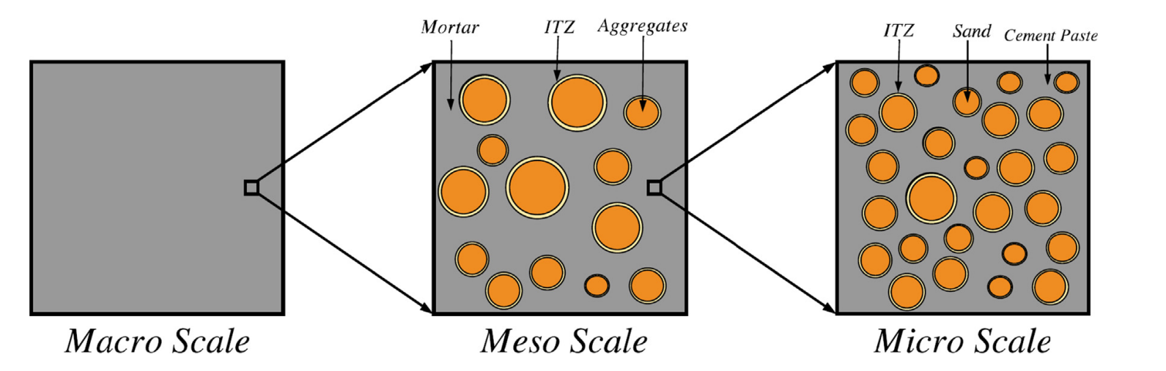
To understand the mechanical behavior and durability characteristics of concrete.
Fracture mechanics of concrete and how to improve the performance of concrete. By using mesoscale models to simulate the behavior of concrete, number of experimental tests can be reduced.
Purpose of Study

Slide 4
Different Method
Continuum Method
Discrete Analysis Method
Different method
To Analysis
Digital based approach
Parameterization approach
Discrete element method
Rigid body spring model

Slide 5
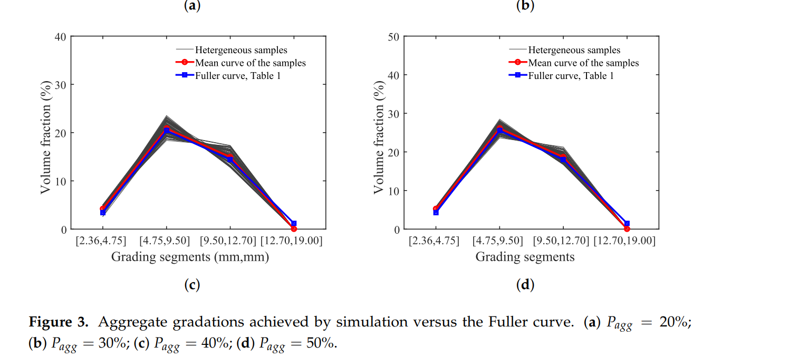
Analysis by different method

Slide 6
Pros and con of method
Continuum Method
Discrete method
Value

Slide 7
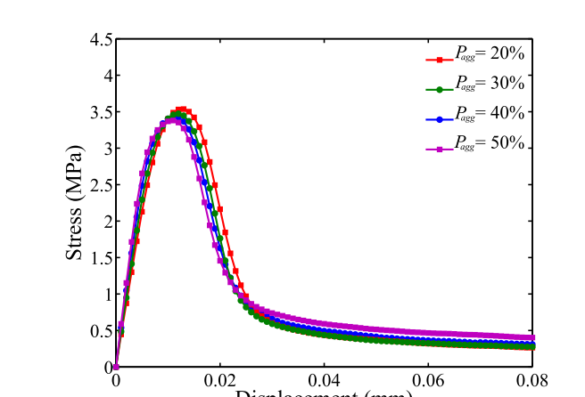
Effect of Aggregate volume fraction
Finding and
result

Slide 8
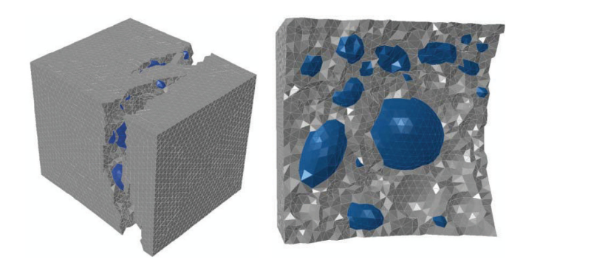
SLIDE 1
SLIDE 2
SLIDE 3
SLIDE 4
SLIDE 5
SLIDE 6
Finding and
result
SLIDE 8

Slide 9
Enhancing material models and damaged parameters for complex loading conditions, such as shear
Studying the influence of particle spacing , surface texture of the coarse aggregate on failure mechanism.
How to reduce diagonal and confined crack of concrete specimen.
. Effect of Loading Increment and Dynamic Relaxation Threshold
Effect of discretization on simulation time
How concrete behave with varying porosity of specimen
Future scope

